Slide 1
Ada Boosting Regression

Slide 2
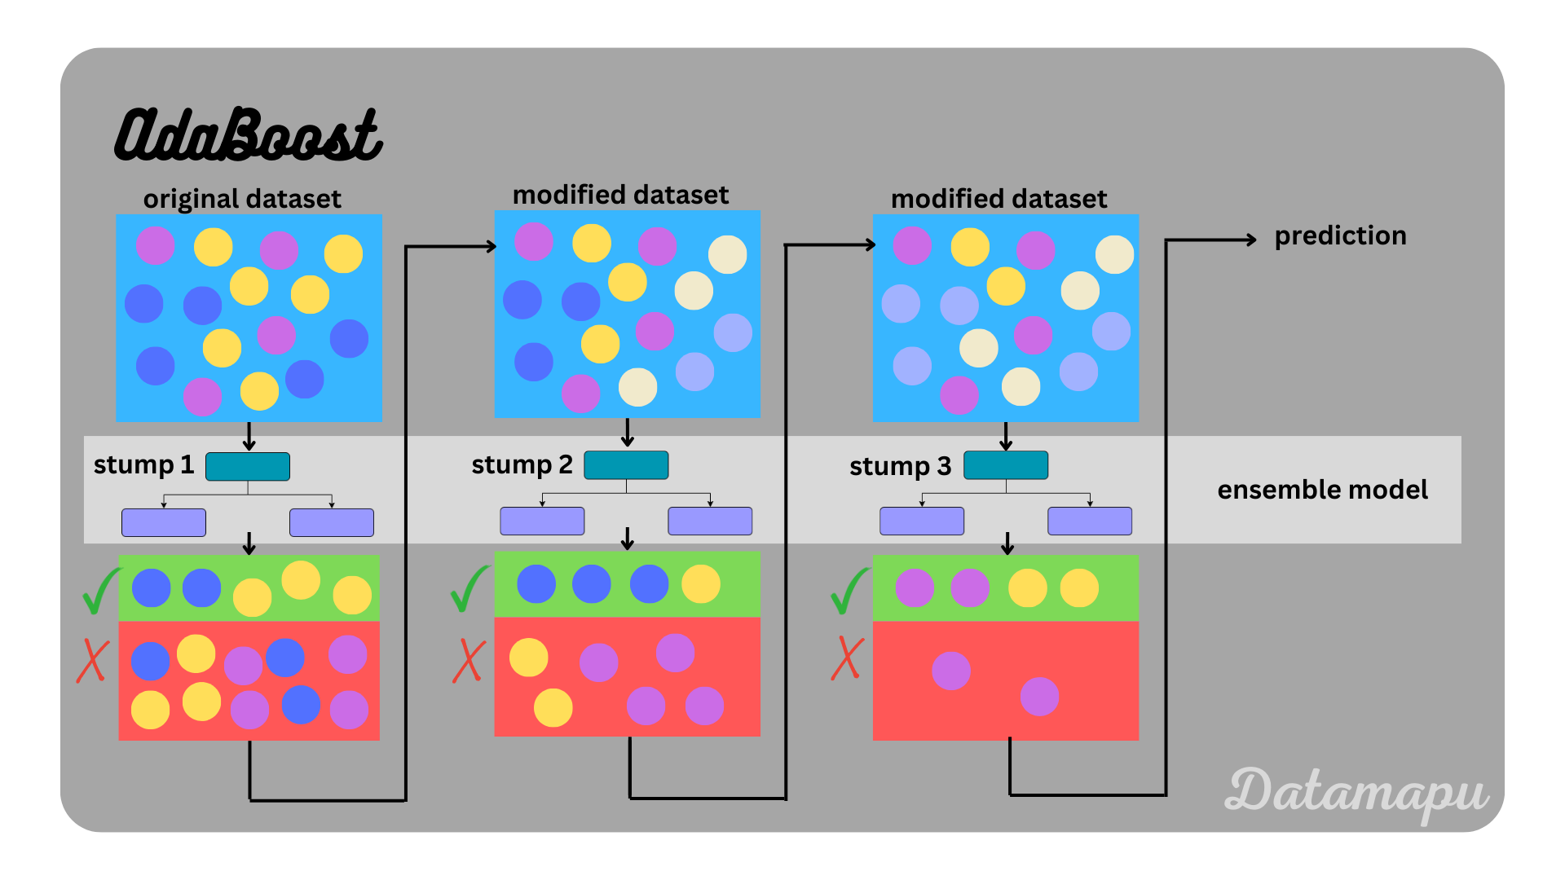
Ada Boosting is a boosting algorithm. It will combines the prediction from the multiple weak learner, by using the stamp decision to form a strong learner. It is a meta-estimator that begins by fitting a regressor on the original dataset and then fits additional copies of the regressor on the same dataset but where the weights of instances are adjusted according to the error of the current prediction.

Slide 3
The weights of the samples are adjusted at each iteration. the data points that were previously misclassified, assigning higher weights to them in subsequent iterations, thus progressively improving the overall prediction accuracy. This process is repeated until the desired performance is achieved.
Dataset
Classified (Strong learners)
Misclassified(weak leaners)
Iteration 1
Iteration 2
Misclassified data
Assigning Higher weights
(new learner is trained on the adjusted data weights based on the previous learner's performance)
Misclassified data(weak leaners)
Weighted Data

Slide 4
Ada Boost Working principle:
Step-1
Step-2
Step-3
Step-4
Training set(assign equal weights to all the data points)
Train a weak learner(using current data weights)
Calculate error rate on the training data.
Update the weights(Adjust the weights of the data points based on their classification results. Misclassified data points receive higher weights, while correctly classified data points receive lower weights).
Step-6 Final Prediction
(combine the predictions from all the weak learners, where each prediction is weighted based on the accuracy of the corresponding weak learner.)
Step-5
Continue steps 2-4, training new weak learners and updating weights until a predefined number of iterations is reached.

Slide 5
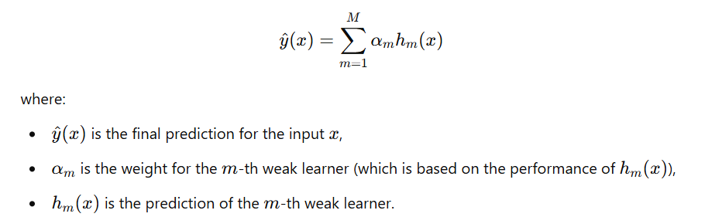
Final Prediction:
Pros:
Improves Weak learners
Handles complex data.
Works well in small dataset
Ada boost regressor is used with decision tree, linear models etc.
Cons:
This will lead to overfitting.
Requires Tuning and proper choice of weak learners to perform well.
Performance depends on the weak learners.
Limited Performance on Highly Correlated Data and Instability in Some Cases.

